Slide 1
Predicting Customer Turnover for Telecom company
BY: Carlos Marin

Slide 2
Outline
Background
Business Problem
Data
Methods
Results
Conclusions

Slide 3

Background
Customer turnover affects every company. For this telecom company, the causes are first identified . Using machine learning identify models that provide the most accurate response for future predictions

Slide 4
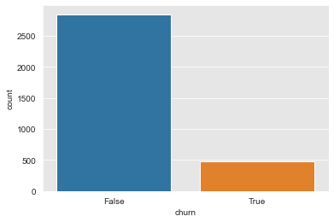
Business Problem
Maximize customer retention
Minimize customer turnover
Identify causes
Develop models that will help predict customer turnover

Slide 5
Data
Using Telecom data set. Dataset has 3333 rows, and 17 columns.
Contains data including
daytime data
night time data
International data
Customer service calls
International plan
Churn/turnover

Slide 6
Methods
Identify variables with statistical significance
Non-Necessary variables were removed.
Calculated outcome occurrence via odds ratio
Split into Train and Test set
Fixing Class Imbalance

Slide 7
Methods
Developed several models to evaluate performance
Precision – correct predictions vs total predictions
Recall – Correct predictions vs actual positive predictions
F1 score – harmonic mean of Precision and Recall
Accuracy
Plotted Feature importance to understand weight of each feature

Slide 8
Results
Looking at Odds ratio data:
international plan customers 7 times more likely to leave.
customer service callers are 55% more likely to leave.
Customers with voicemail plan 84% less likely to leave

Slide 9
Results
Lowest score model was 0.70
All other models had accuracy score of 0.87
Alternative deciding factor, f1 score
Best scoring model had f1 score of 0.55 (Random Forests)

Slide 10
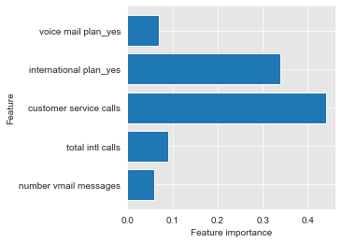
Results
Feature Importance results
Customer service calls and International Plans top two features for turnover.

Slide 11
Summary of Findings / Conclusion
International plan holders, are 7 times more likely to leave.
Customer service callers are 55% more likely to leave.
customer services calls and total international plans were top two important features
Most models had similar accuracy
F1 score, deciding factor. Random Forests best model.

Slide 12

Thank you!

